Slide 1

Data mining project
"Titanic Survival Prediction and Analysis”

Slide 2

Agenda:
Introduction
Objectives
Data Overview
Data Exploration
Model Building
Model Evaluation
Conclusion

Slide 3

Introduction
we explore the tragic sinking of the Titanic in 1912, aiming to answer one critical question: What were the factors that determined who survived and who did not?
The Titanic disaster claimed the lives of more than 1,500 passengers and crew members, making it one of the deadliest maritime tragedies in history.

Slide 4

Overview of the dataset
The Titanic Dataset is a dataset curated on the basis of the passengers on titanic, like their age, class, gender, etc.. to predict if they would have survived or not.
While there was some element of luck involved in surviving, it seems some groups of people were more likely to survive than others.

Slide 5
Model building
building a predictive model to analyze whether a random passenger will survive based on their age, gender, cabin, Fare, and more. First, we will visualize data and then, based on it, adjust the parameter values according to our requirements.

Slide 6
Objectives
Survival Prediction: Build a strong classification model to predict whether the passenger survives or not.
Insight Discovery: To uncover meaningful insights and patterns within the Titanic dataset, shedding light on the factors that influenced passenger survival.
compare the evaluation metrics of various classification algorithms.

Slide 7
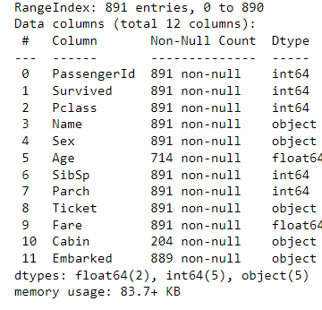
About Dataset
Dataset has 891 rows and 12 columns
7 Numerical variables and 5 categorical variables
The predefined columns are :
Passenger ID - To identify unique passengers
Survived - If they survived or not
P Class - The class passengers travelled in
Name - Passenger Name
Sex - Gender of Passenger
Age - Age of passenger
SibSp - Number of siblings or spouse
Parch - Parent or child
Ticket - Ticket number
Fare - Amount paid for the ticket
Cabin - Cabin of residence
Embarked - Point of embarkment
Before doing Univariate analysis , first as we don't need features 'Name','Ticket‘ and 'PassengerId' , so we drop them

Slide 8
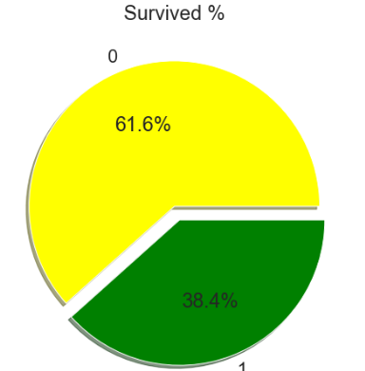
The target variable Is Survived column 0 = not Survived 1 = Survived

Slide 9
Exploratory Analysis

Slide 10
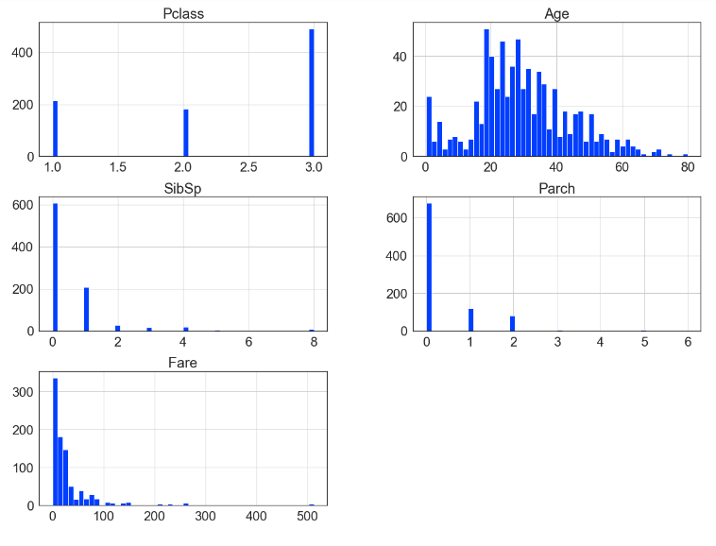
Univariate Analysis for continues variables

Slide 11
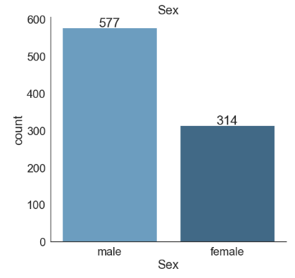
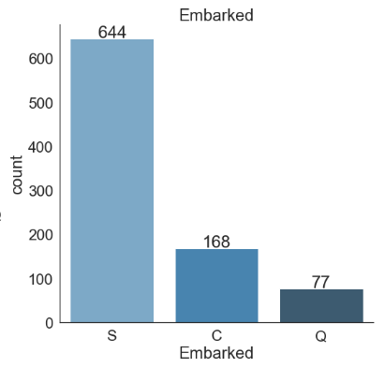
Univariate Analysis for categorical variables

Slide 12
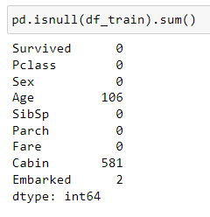
Data Cleansing
1 - manage duplicated values :
Data set had 107 duplicated variables that were dropped
2 – Missing Values :
3 columns have missing value :
The number of missing value for feature Cabin is more that 50% of total observations , so we decided to drop these column :
df_train = df_train.dropna(thresh = 400,axis =1 )
The number of missing value of Embarked is just 2 , so we filled it with Forward Fill Method

Slide 13
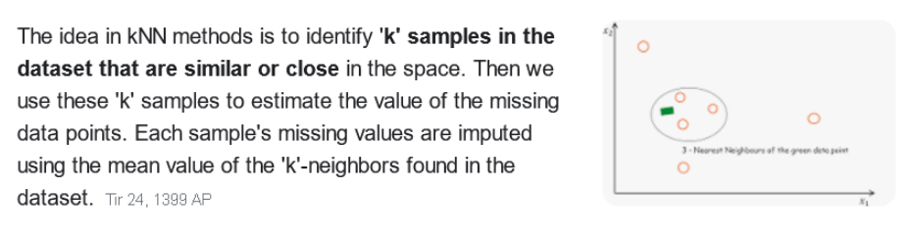
The most important feature having maximum missing value is Age with 106 missing Value , for imputing
this feature we used KNN Imputer form Library sklearn.impute , we used the number of 5 neighbors for imputing each missing value

Slide 14
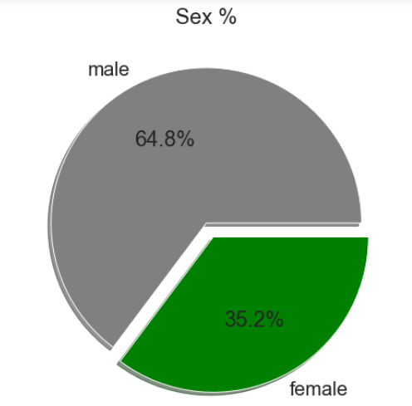
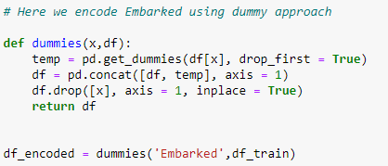
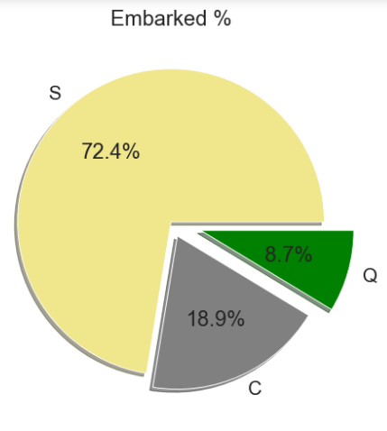
Encoding
Features Embarked and Sex has to be encoded before we go for modeling
To encode Embarked Dummies method is used and also we mapped all female to 0 and all men to 1 using function man()

Slide 15
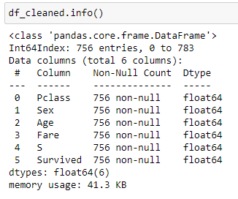
Handling Outlier
We applied LOF from library sklearn.neighbors for find and delete anomaly rows
After doing all data cleansing steps now we have 756 observations and 6 columns

Slide 16
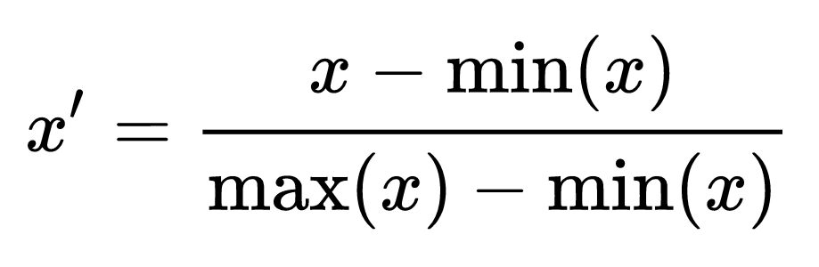
Scaling Data
For scaling data MinMaxScaler was used

Slide 17
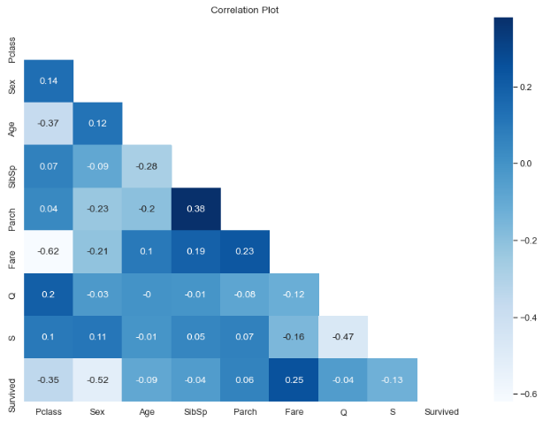
Correlation

Slide 18
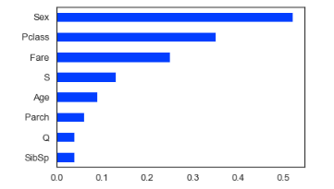
We plotted the last row of correlation between variables to look how independent variables associate with target and because Parch,Q and SibSp has low corr with survival rate, hence we drop them

Slide 19
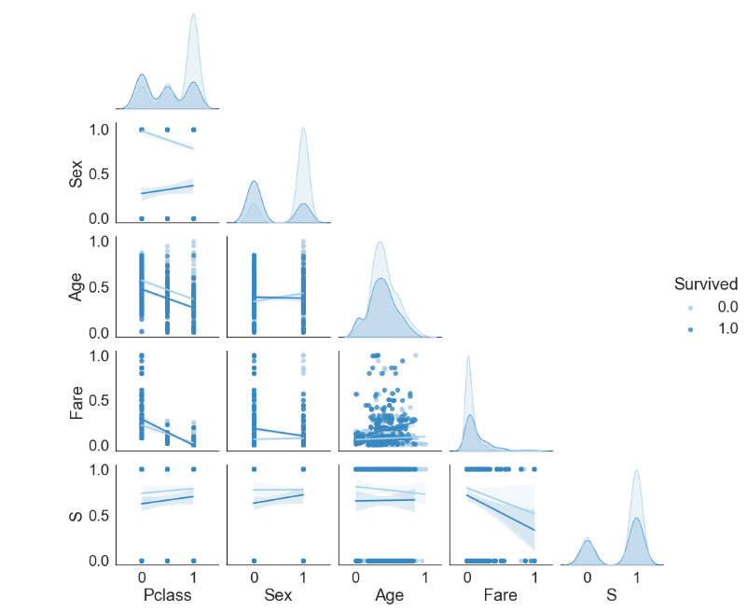
Plotting the correlation between features and distribution of each one

Slide 20
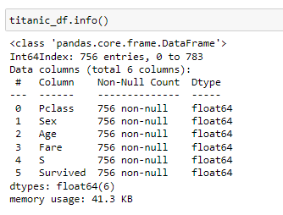
The final dataset has 756 observations and 6 columns

Slide 21
Modeling
For modeling we used 4 different algorithms:
Multinomial Naive Bayes
Gaussian Naive Bayes
Logistic Regression
Random Forest

Slide 22
Multinomial Naive Bayes (MultinomialNB)
is a variant of the Naive Bayes algorithm, specifically designed for text classification tasks. It is commonly used for problems where the features are discrete and represent the frequency of words or terms in a document, making it suitable for text data like email categorization, spam detection, and document classification.
We applied cross validation wirth cv =10 , scoring = 'accuracy'
Train accuracy score : 0.6969672131147541
Test accuracy score : 0.7641666666666667

Slide 23
Gaussian Naive Bayes
which is a variant of the Naive Bayes algorithm specifically designed for classification tasks when dealing with continuous-valued features that are assumed to follow a Gaussian (normal) distribution
We applied cross validation wirth cv =10 , scoring = 'accuracy'
Train accuracy score : 0.7730874316939891
Test accuracy score : 0.7975

Slide 24
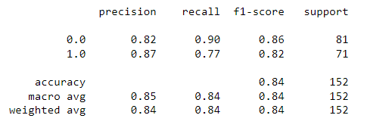
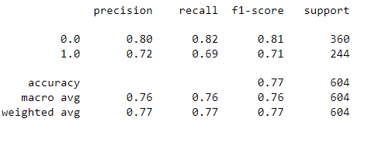
Logistic Regression
We applied train_test_split
Classification report for test data
Classification report for train data

Slide 25
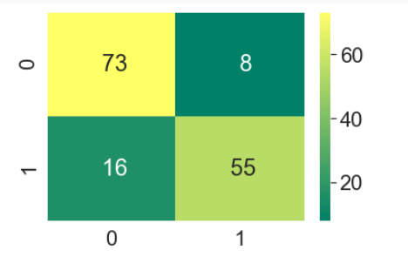
Confusion Matrix :

Slide 26

Random Forest Classifier
The Random Forest Classifier is a popular ensemble learning algorithm used for classification tasks. It's a part of the scikit-learn library in Python and is based on the Random Forest ensemble method.
Train accuracy score : 0.9884105960264901
Test accuracy score : 0.743421052631579

Slide 27
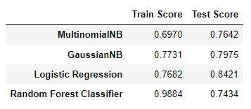
Comparison all 4 models :

Slide 28
Conclusion
1. MultinomialNB:
The training score (0.6970) is lower than the test score (0.7642), indicating that the model is not overfitting. In fact, the test score is higher than the training score, which suggests that the model might benefit from more complex features or additional training data.
2. GaussianNB: The training score (0.7731) is lower than the test score (0.7975), which is generally a good sign. It suggests that the Gaussian Naive Bayes model is not overfitting.
3. Logistic Regression:
The training score (0.7682) is lower than the test score (0.8421), which is also a positive sign. It indicates that the Logistic Regression model is not overfitting and performs well on the test data.
4. Random Forest Classifier:
The Random Forest Classifier shows a significant difference between the training score (0.9884) and the test score (0.7434). This large gap between the two scores is indicative of overfitting.

Slide 29

Thank you.. Any Question

